Slide 1

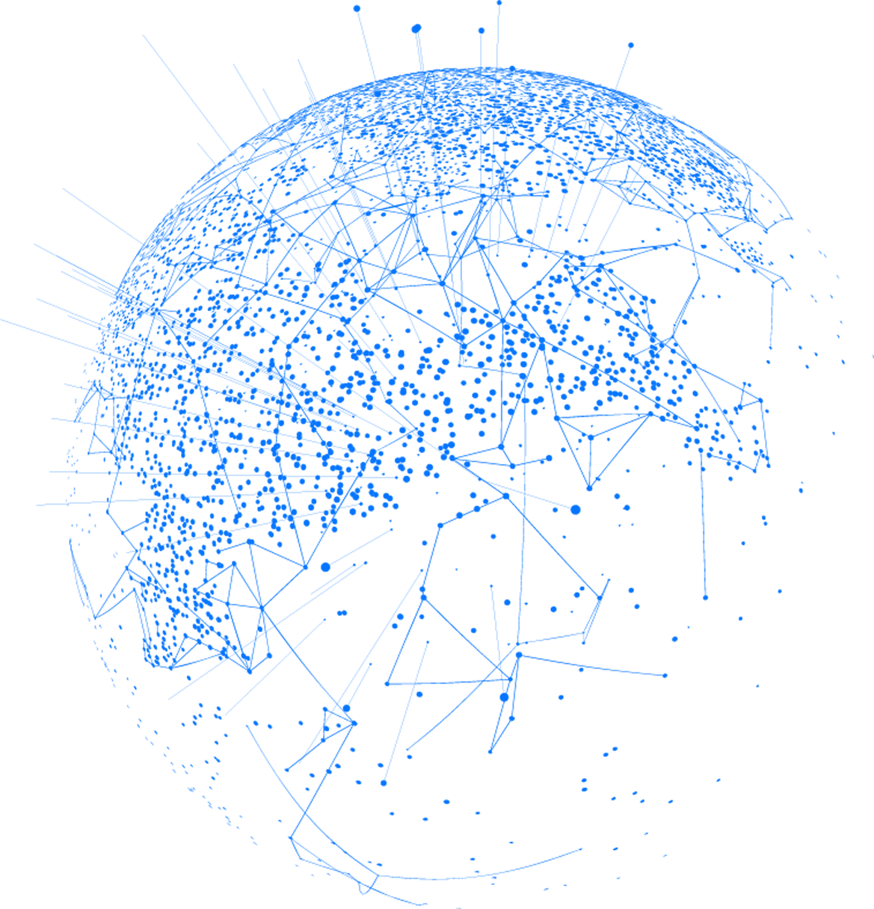
MINOR PROJECT PRESENTATION
SUBMITTED IN PARTIAL FULFILLMENT OF THE REQUIREMENTS FOR THE AWARD OF THE DEGREE OF
B. TECH IN COMPUTER IN COMPUTER SCIENCE AND ENGINEERING
BY
HARSH VARDHAN SINGH
RANVIR RANVIJAY SINGH
AADITYA KUMAR
BTECH/60304/21
BTECH/60301/21
BTECH/60308/21
UNDER THE GUIDANCE OF
DR. SOUMYA RAY
DEPARTMENT OF CSE
BIT DEOGHAR CAMPUS

Slide 2

NETDEFENDER
TOOLKIT
A CLOUD BASED CYBER SECURITY AND MONITORING TOOL
01

Slide 3


S. NO. | TOPIC | SLIDE NO.
1. | INTRODUCTION | 3-6
2. | PROBLEM DEFINITION | 7-9
3. | RELATED WORK | 10-15
4. | PROPOSED WORK/MODEL | 16-22
5. | CONCLUSION | 23
6. | REFERENCES | 24
02

Slide 4
INTRODUCTION
The NetDefender Toolkit is a cloud based cyber security tools that combines three essential tools that enhance network monitoring, protection, and vulnerability assessment through user-friendly and scalable modules. The toolkit bridges the gap between complex cybersecurity functionalities and ease of use. It’s modular design ensures adaptability for both individuals and organizations, strengthening digital security.
03

Slide 5
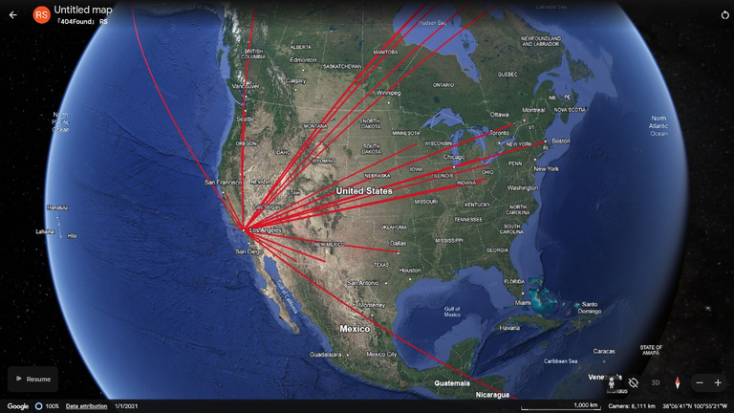

INTRODUCTION
MODULE-1
IP ADDRESS VISUALISATION TOOL
Analyzes network traffic in real-time, identifies source and destination IP address.
Maps IP address geographically using Wireshark, Python, and Google My Maps for intuitive visualization.
Enables network administrators to detect traffic patterns, identify anomalies, and trace potential threats efficiently.
04

Slide 6

INTRODUCTION
MODULE-2
PASSWORD GENERATOR TOOL
Creates highly secure, customizable passwords tailored to user-defined specifications.
Protects against brute-force and dictionary attacks using robust randomization techniques.
Designed for both personal and organizational use, ensuring privacy and strong password management.
05

Slide 7
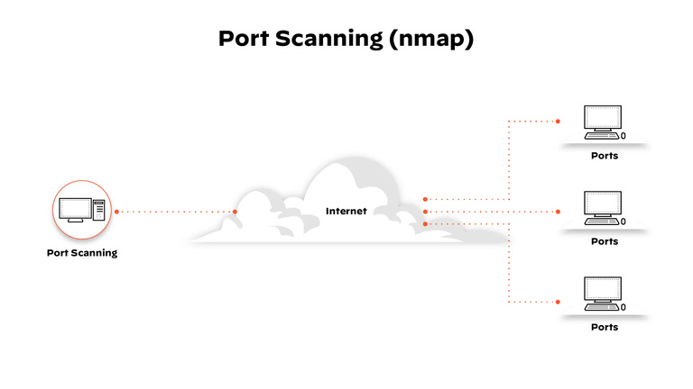
INTRODUCTION
MODULE-3
NMAP SCANNER TOOL
Simplifies network scanning and vulnerability detection using the Nmap utility
Offers pre-configured options for beginners and custom commands for advanced users
Provides real-time scan outputs and downloadable reports, making it a versatile tool for network security analysis.
06

Slide 8
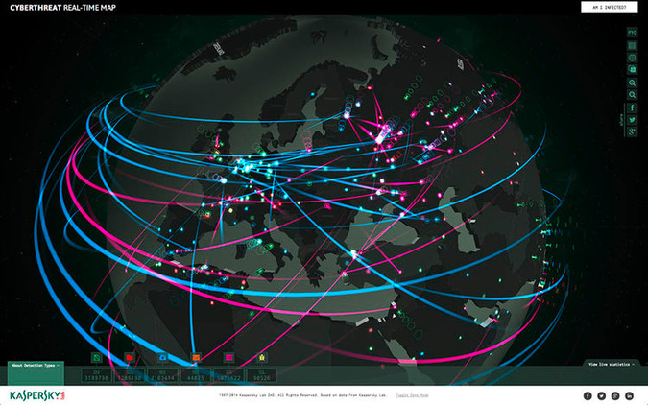
PROBLEM DEFINITION
MODULE-1
IP ADDRESS VISUALISATION TOOL
Traditional network monitoring tools lack geographical visualization of IP traffic, making it challenging to trace the origin of attacks and detect unusual patterns. This limitation reduces the ability of network administrators to respond proactively to potential threats in real time.
07

Slide 9

PROBLEM DEFINITION
MODULE-2
PASSWORD GENERATOR TOOL
Weak or predictable passwords are a primary cause of unauthorized access and security breaches, leaving systems vulnerable to brute-force and dictionary attacks.
08

Slide 10
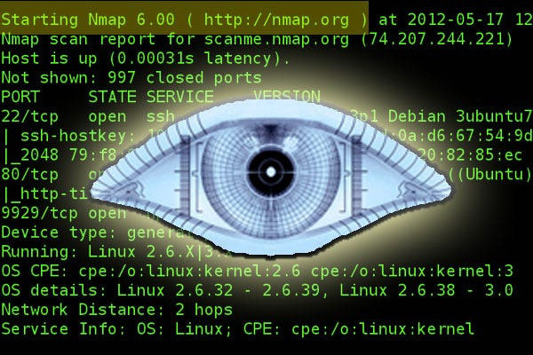
PROBLEM DEFINITION
MODULE-3
NMAP SCANNER TOOL
Command-line network scanning tools like Nmap are complex for non-expert users, limiting accessibility for comprehensive network security assessments. Without simplified interfaces, organizations face challenges in identifying and mitigating vulnerabilities efficiently.
09

Slide 11

RELATED WORKS/ LITERATURE SURVEY
1. Existing Tools and Models
Wireshark: Widely used for real-time packet analysis and network monitoring. Lacks intuitive geographical visualization for IP traffic.
Nmap: Powerful network scanning and vulnerability assessment tool.
Command-line interface complexity limits usability for beginners.
Password Generators: Most existing tools offer basic password generation but lack customization or offline functionality.
2. Gaps in Current Solutions
Complexity: Existing tools are often difficult for non-experts to use effectively.
Lack of Integration: Separate tools for traffic visualization, password security, and scanning lead to inefficiencies.
10

Slide 12
HOW OUR WORK IS BETTER
1. Unified Toolkit
Combines IP Visualization, Password Generator, and Nmap Scanner into a single, modular platform.
Eliminates the need for separate tools, improving efficiency and user experience.
2. User-Friendly Design
Simplified interfaces make advanced functionalities accessible to both beginners and experts.
Modular design allows customization for different user needs.
3. Enhanced Features
IP Visualization: Adds real-time geolocation mapping of IP traffic, improving threat identification.
Password Generator: Offers highly customizable, offline password creation with advanced security features.
Nmap Scanner: Provides a GUI for effortless network scanning with preconfigured and customizable options.
4. Cloud Scalability (Future Work)
Hosting the toolkit on the cloud ensures accessibility, scalability, and seamless collaboration across platforms.
11

Slide 13


WORKING MODEL
FUNCTIONAL REQUIREMENTS:
1. IP Visualization Tool:-
Capture live network traffic and process `.pcap` files.
Geolocate IP addresses and visualize them on an interactive map.
2. Password Generator Tool:-
Generate customizable and highly secure passwords.
Support user-defined parameters (length, character types).
3. Nmap Scanner Tool:-
Conduct basic, intermediate, and advanced network scans.
Display real-time outputs and allow downloadable scan results.
12

Slide 14
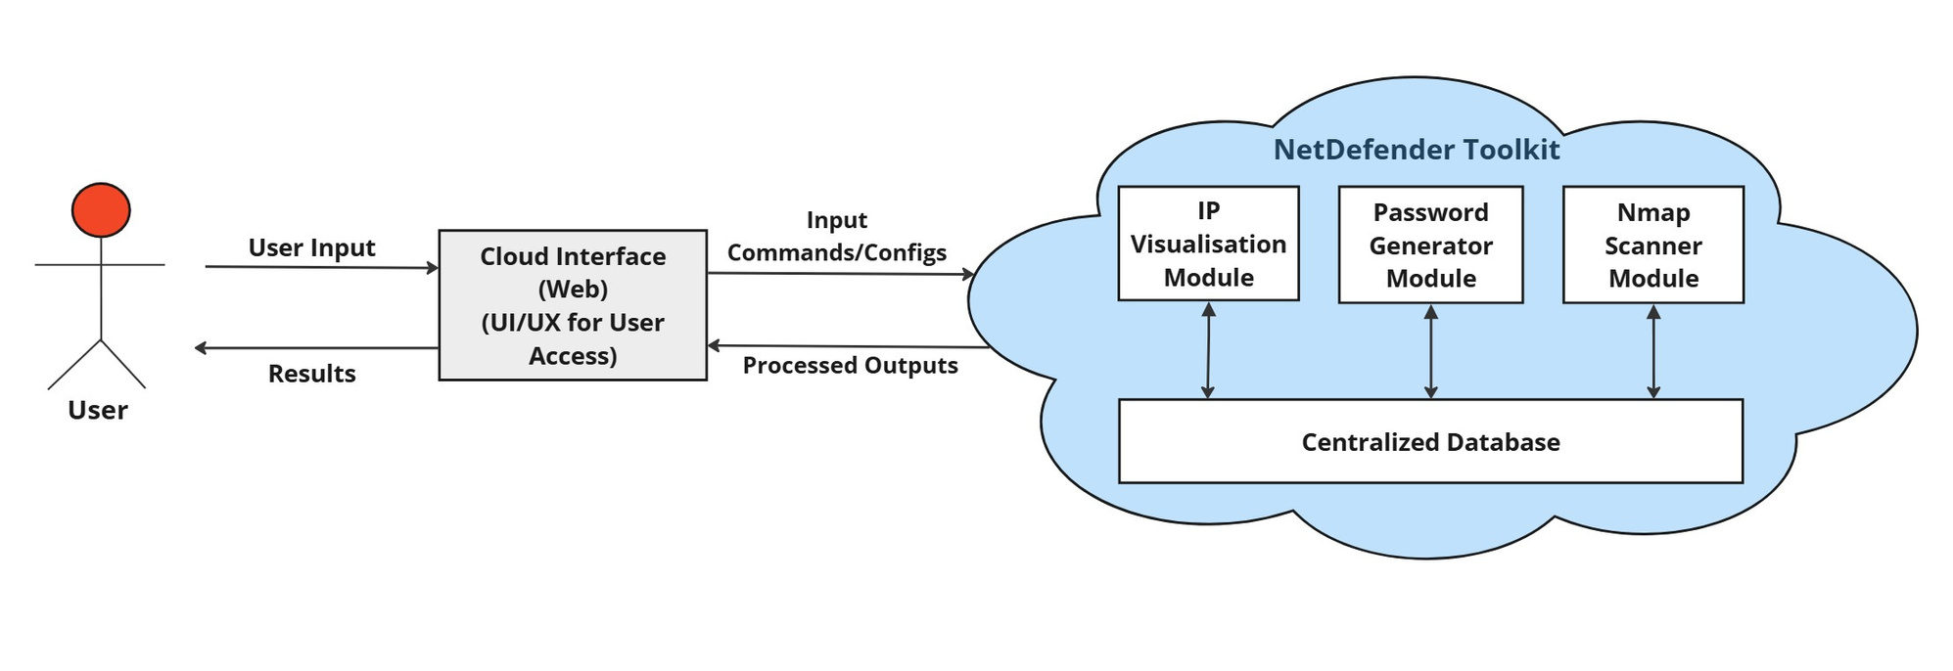
USE-CASE DIAGRAM:-
13

Slide 15
EXPERIMENTAL SETUP
Tools Used : Wireshark (traffic capture), Python (processing), Google My Maps (visualization), Nmap (scanning).
Development Environment:
- Programming: Python, Django Framework.
- Libraries: `pyshark`, `GeoIP`, `random`, `simplekml`.
Testing Environment:
- Multiple network topologies (local and public).
- Systems: Linux and Windows.
14

Slide 16
ACTIVITY DIAGRAM: IP VISUALIZATION TOOL
Start
Capture Traffic or Load File
Extract IP Addresses
Geolocate IPs
Generate KML File
Display on Map
End
15

Slide 17
PROPOSED METHODOLOGY
VULNERABILITY LIFECYCLE IN NMAP SCANNER TOOL
1. Discovery:
Use Nmap to detect open ports, services, and potential vulnerabilities in the network.
2. Analysis:
Evaluate scan results to assess the risk and impact of detected vulnerabilities.
3. Remediation:
Suggest mitigation measures such as closing unnecessary ports or updating insecure services.
4. Verification:
Re-scan the network after remediation to ensure vulnerabilities are resolved.
5. Continuous Monitoring:
Schedule periodic scans to identify new vulnerabilities and maintain network security.
16

Slide 18
ACTIVITY DIAGRAM: NMAP SCANNER TOOL
Start
Scan Network
Identify Vulnerabilities
Analyze Risks
Recommend Actions
Remediate Vulnerabilities
Re-Scan & Verify
Monitor Continuously
End
17

Slide 19
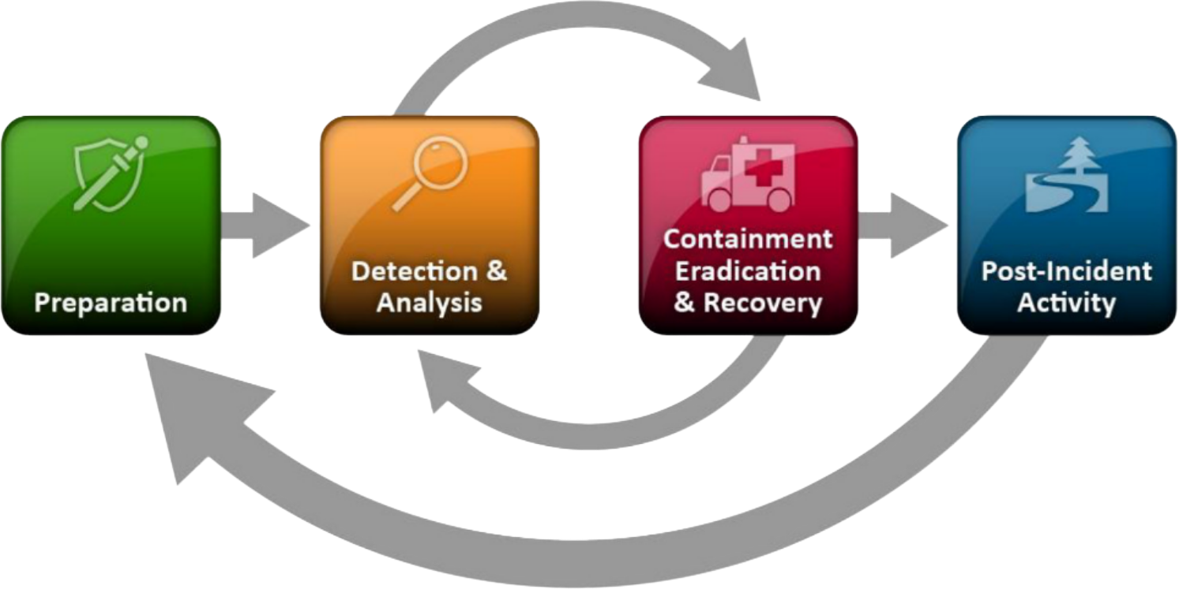
NIST INCIDENT HANDLING METHODOLOGY FOR IP VISUALIZATION TOOL
1. Preparation
Set up IP Visualization Tool with Wireshark and Googlemy Maps for real-time monitoring.
2. Detection and Analysis
Monitor and analyze IP traffic for geographic anomalies or suspicious patterns.
3. Containment, Eradication, and Recovery
Block suspicious IPs and mitigate threats.
Recover and verify network integrity using geolocation insights.
4. Post-Incident Activity
Review and update detection methods based on incident data.
18

Slide 20
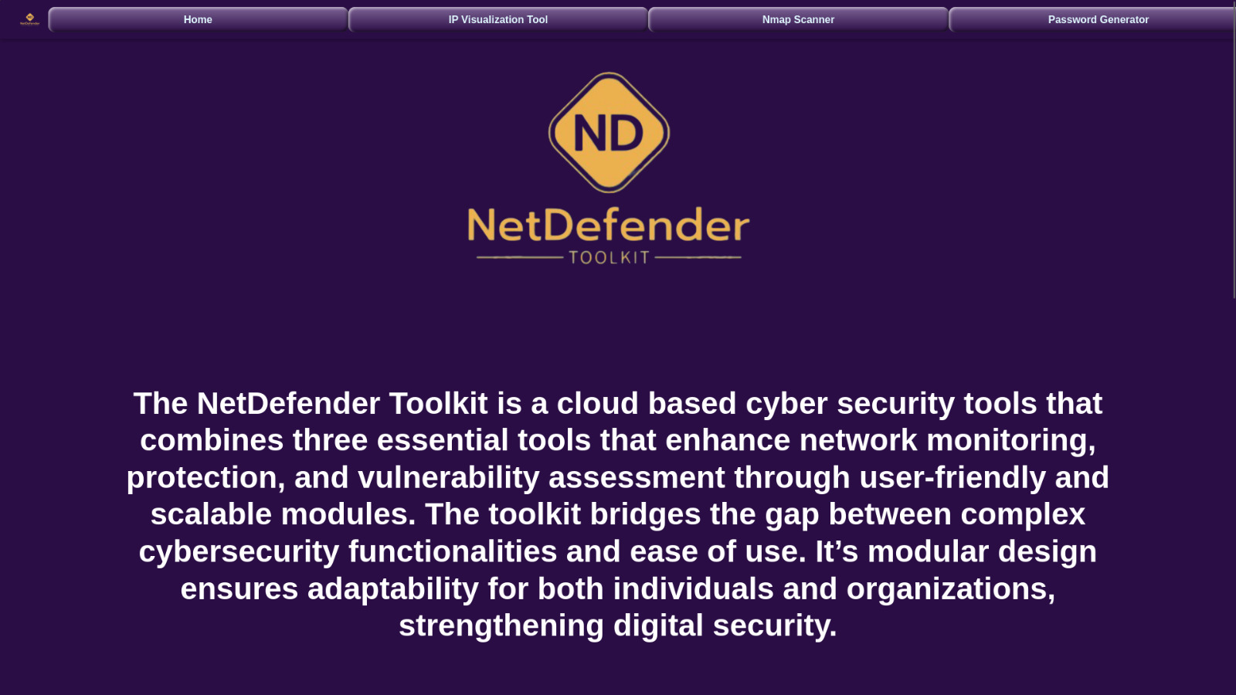
IMAGES
19
Fig.-1 Home Page

Slide 21
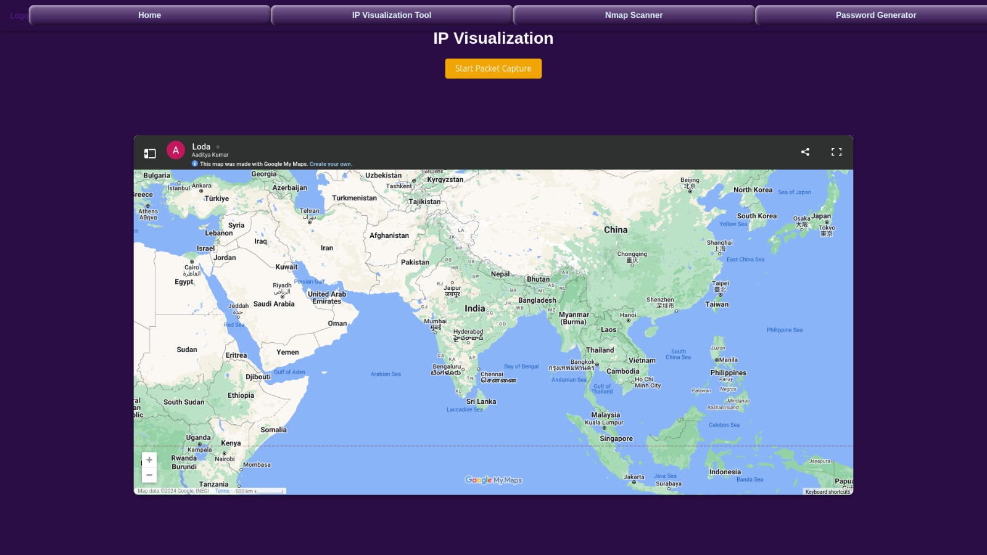
20
Fig.-2 IP Visualisation Tool

Slide 22
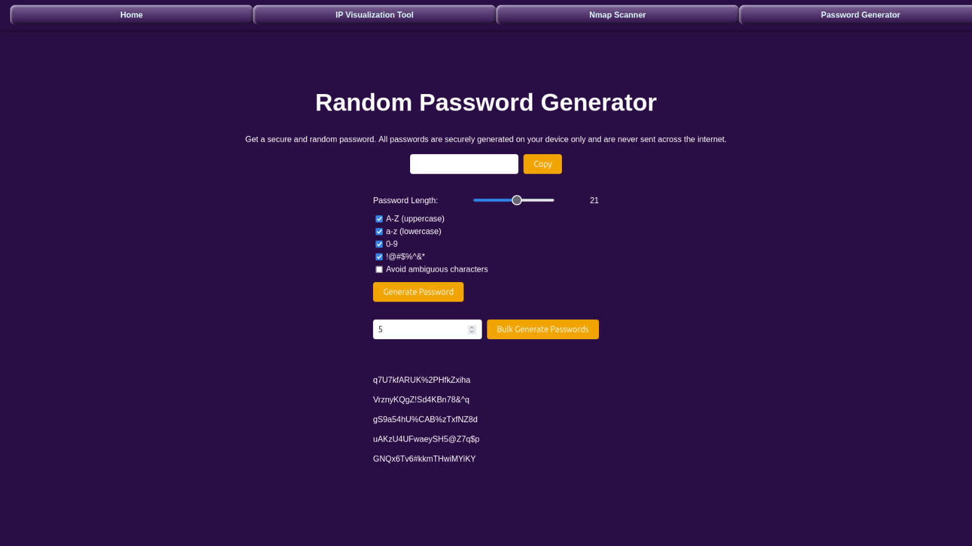
21
Fig.-3 Password Generator Tool

Slide 23
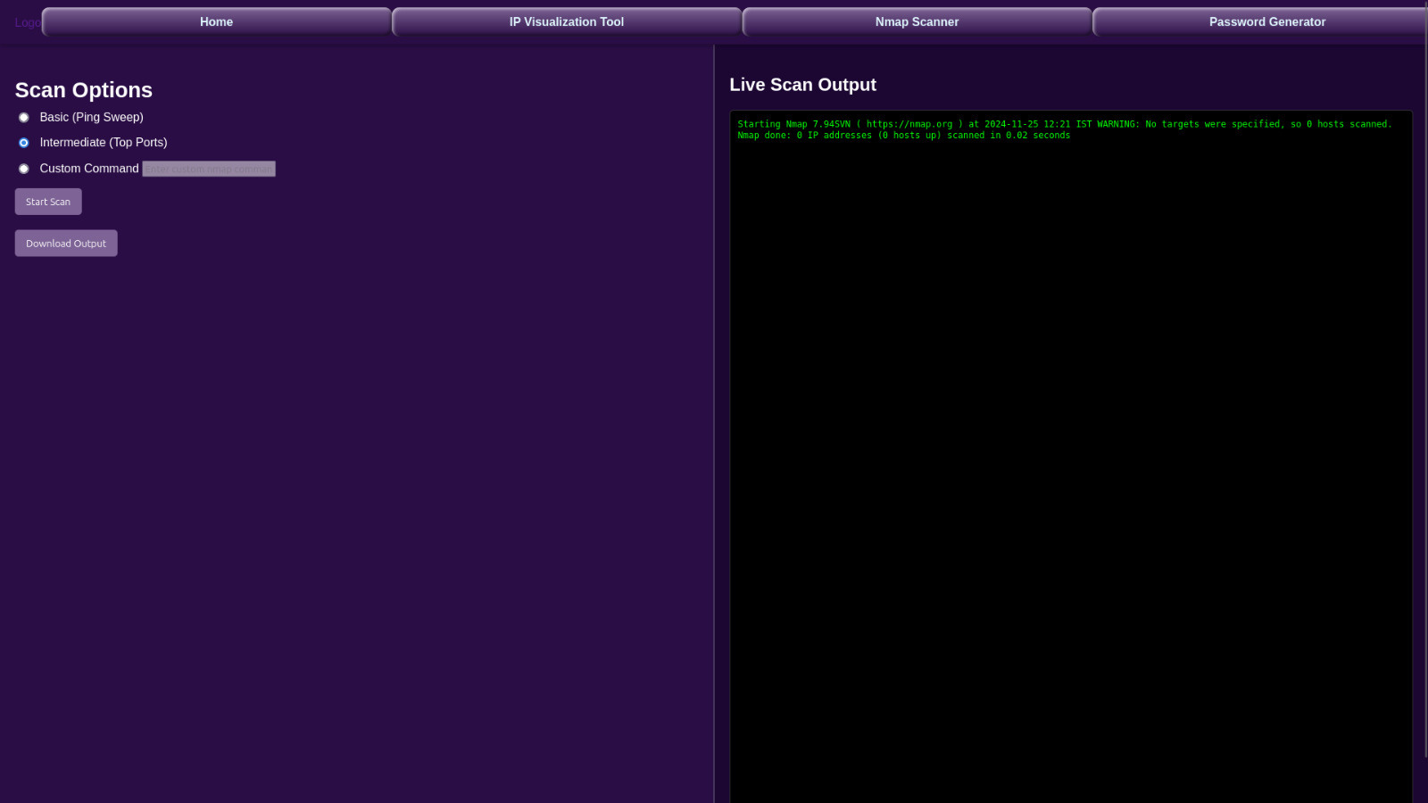
22
Fig.-4 Nmap Scanner Tool

Slide 24
CONCLUSION AND FUTURE WORK
Conclusion
The NetDefender Toolkit provides an integrated, user-friendly solution for IP visualization, secure password generation, and network scanning.
Combines simplicity and advanced functionality, making cybersecurity tools accessible to both beginners and experts.
Ensures proactive threat detection, improved security posture, and effective incident management.
Future Work
Cloud Deployment: Host the toolkit on the cloud for enhanced scalability and global accessibility.
AI Integration: Implement AI algorithms for anomaly detection and predictive threat analysis.
Real-Time Collaboration: Enable multi-user interaction for teams managing large networks.
Expanded Features: Add malware detection and vulnerability scoring for enhanced threat management.
23

Slide 25
REFERENCES:-
1. https://indusedu.org/pdfs/IJREISS/IJREISS_2136_66085.pdf
2. https://nmap.org/book/nmap-overview-and-demos.html
3. https://www.wireshark.org/docs/wsug_html_chunked/
4.https://www.academia.edu/105724614/A_technical_investigation_into_port_scanning_using_N map
5. https://en.wikipedia.org/wiki/Nmap
6. https://en.wikipedia.org/wiki/Random_password_generator
7. https://threatmap.checkpoint.com/
24

Slide 26




TEAM
MEMBERS
RANVIR SINGH
HARSH VARDHAN SINGH
AADITYA KUMAR

Slide 27
THANK
YOU

